Slide 1
INTERNAL INTRUSION DETECTION SYSTEM
PRESENTING BY,
ABILASH.C
PRABHUDEVA.B
KARTHINIVASH.G.S
ANANDHAKUMAR.R
GUIDED BY,
Dr. VIMALARANI.C

Slide 2
Objective
User IDs and passwords are used for authentication. However the passwords are shared between users in some cases
That will result in internal attacking of the system, so there would be more chances of attackers stole the user details.
Hence a security system is required. The Security system for this purpose is called Internal Intrusion Detection System(IIDS)

Slide 3
Definitions
Intrusion
  A set of actions aimed to compromise the security goals, namely
    Integrity, confidentiality, or availability, of a computing and networking resource
Intrusion detection
  The process of identifying and responding to intrusion activities

Slide 4
ABSTRACT
Currently, most computer systems use user IDs and passwords as the login patterns to authenticate users. However, many people share their login patterns with co-workers and request their co-workers to assist on co-tasks, thereby making the pattern as one of the weakest points of computer security.
Insider attackers, the invalid users of a system who attack the system internally, are hard to detect since most intrusion detection systems and firewalls identify and isolate malicious behaviors launched from the outside world of the system only.
In addition, some studies claimed that analyzing system calls (SCs) generated by commands can identify these commands, with which to accurately detect attacks, and attack patterns are the features of an attack.
The IIDS creates user’s personal profiles to keep track of user’s usage habits as their forensic features and determines whether a valid login user is the account holder or not by comparing his/her current computer usage behaviors with the patterns collected in the account holder’s personal profile.
The experimental results demonstrate that it can prevent a protected system from insider attacks effectively and efficiently.

Slide 5
Introduction
Security has been one of the serious problems in the computer domain in the recent years.
Attackers regularly try to penetrate computer systems and behave maliciously
It is also not easy to identify whether a system is under attack or not.
Hence a security mechanism must be implemented.

Slide 6
Literature Survey
Computer forensics science views attacked computer systems as crime scenes.
The aim is to identify, preserve, recover, analyze and opinions on information collected.
Drawbacks:
Identifying attackers is challenging

Slide 7
Existing Problems
Many types of attacks are made on the system.
Insider attack is on of them.
It is difficult to identify because the attacker is using the user’s legitimate authentication.

Slide 8
Drawbacks of Existing System
Time Consuming
Probability of failure is high
Identifying attackers is still a big challenge

Slide 9
Proposed System
The aim of the proposed system is to develop a system with improved facilities.
The proposed system can overcome the performance of the existing system.
In the proposed system the system calls (SCs) are being used to detect the inside attackers.

Slide 10
Advantages of the proposed System
Performance is improved
Easy Detection
System calls are used to identify internal attackers thus improving efficiency

Slide 11

Module Split up
User Module
Admin Module

Slide 12
Modules Explanation
Admin Module
    Log in
    View Log Files
    Eliminate Hacker
User Module
    User Registration
    Login
    Update Profile
    Upload File
    View Upload File
    View System Call

Slide 13
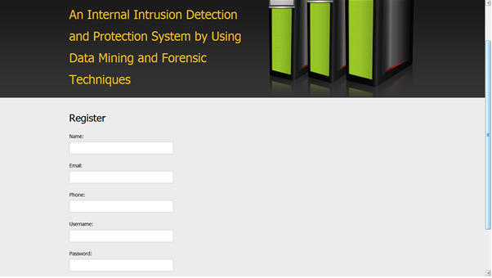
USER REGISTRATION

Slide 14
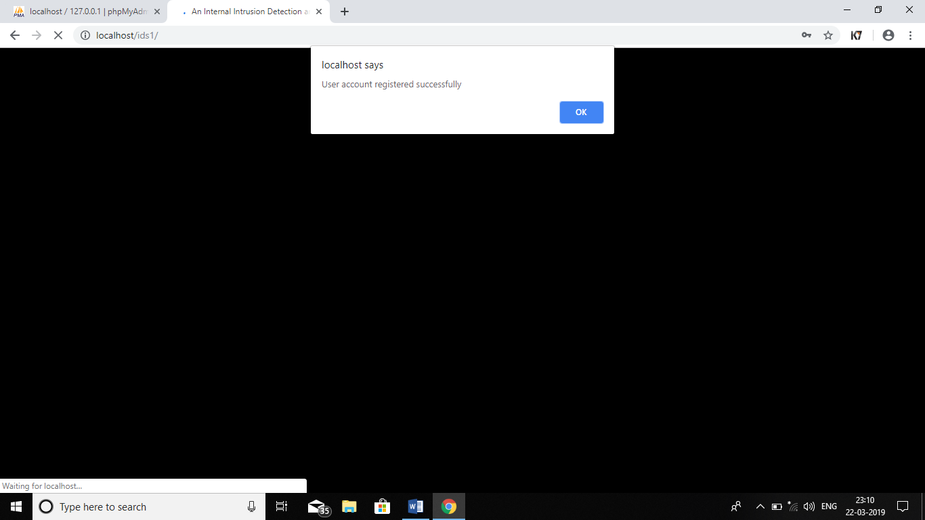
USER REGISTRATION SUCCESSFUL

Slide 15
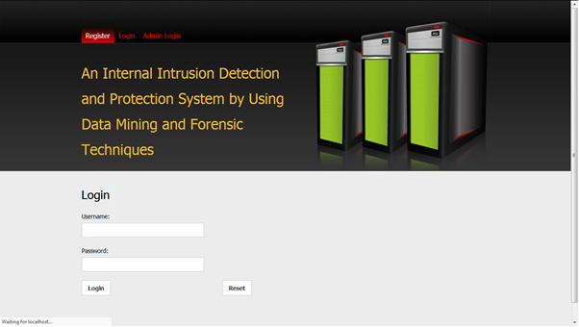
USER LOGIN

Slide 16
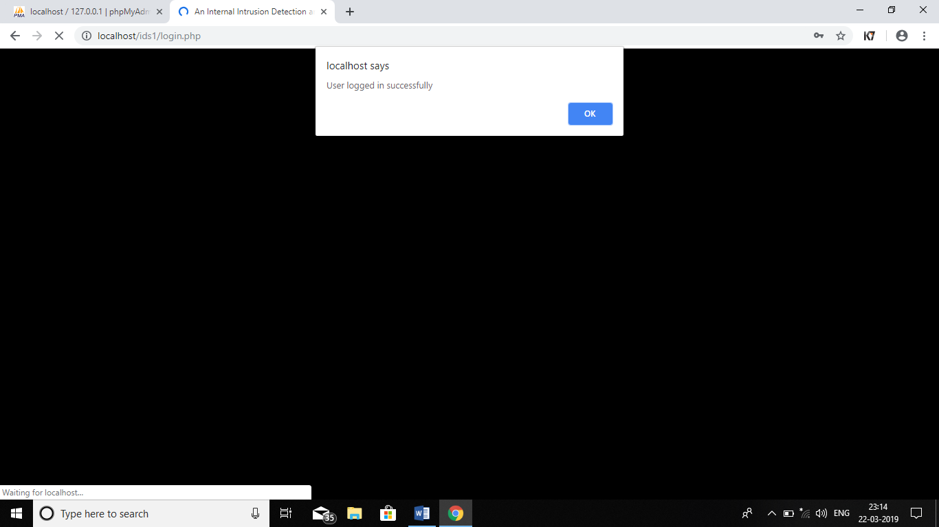
USER LOGIN SUCCESSFUL

Slide 17
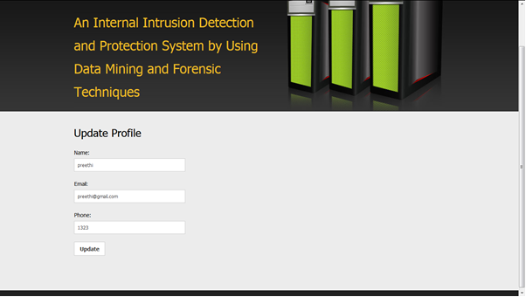
USER UPDATE PROFILE

Slide 18
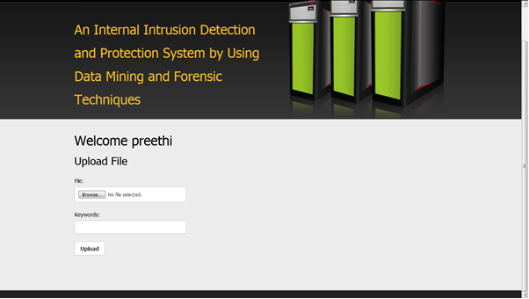
UPLOADING A FILE

Slide 19
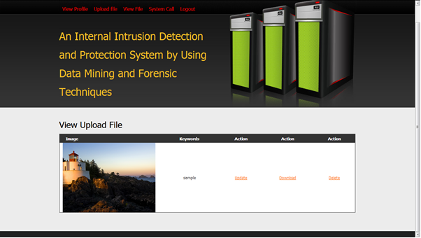
VIEW UPLOADED FILE

Slide 20
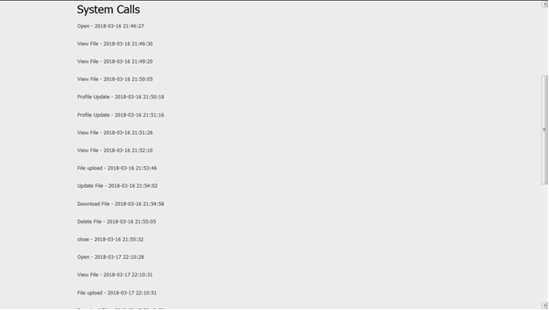
VIEW SYSTEM CALLS

Slide 21

ADMIN LOGIN

Slide 22
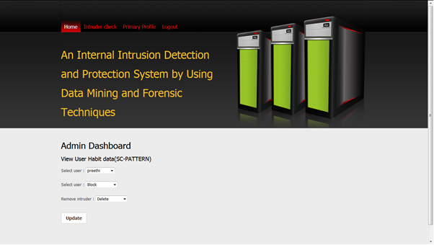
ADMIN DASHBOARD

Slide 23
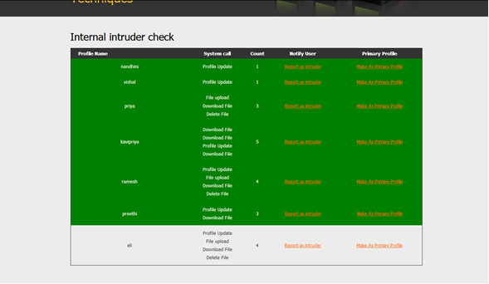
ADMIN VIEWING USERS SYSTEM CALL

Slide 24

USER VIEWING INTRUDER NOTIFICATION

Slide 25

CONT

Slide 26
CONCLUSION:
In this paper, we have proposed an approach that employs data mining and
forensic techniques to identify the representative SC-patterns for a user.
The time that a habitual SC-pattern appears in the user’s log file is counted, the
most commonly used SC-patterns are filtered out, and then a user’s profile is
established.
By identifying a user’s SC-patterns as user’s computer usage habits from the user’s current input SCs, the IIDS resists suspected attackers.
The experimental results demonstrate that the IIDS can assist system administrators to point out an insider or an attacker in a
closed environment.
The further study will be done by improving IIDS’s performance and investigating third-party shell commands.

Slide 27

IIDS
The IIDS can assist system administrators to point out an insider or an attacker in a closed environment

Slide 28
References
[1] S. Gajek, A. Sadeghi, C. Stuble, and M. Winandy, “Compartmented security for browsers—Or how to thwart a phisher with trusted computing,” in Proc. IEEE Int. Conf. Avail., Rel. Security, Vienna, Austria, Apr. 2007, pp. 120–127.
[2] C. Yue and H. Wang, “BogusBiter: A transparent protection against phishing attacks,” ACM Trans. Int. Technol., vol. 10, no. 2, pp. 1–31, May 2010.
[3] Q. Chen, S. Abdelwahed, and A. Erradi, “A model-based approach to self-protection in computing system,” in Proc. ACM Cloud Autonomic Comput. Conf., Miami, FL, USA, 2013, pp. 1–10.

